Slide 1

Title: Feature Extraction and Price Prediction for Mobile Phones Subtitle: Using Machine Learning for Smart Pricing
Presented by: Dhruv godhasara Date: 23 May 2025

Slide 2
Objectives
Extract relevant features from mobile phone data
Train machine learning models to predict prices
Evaluate model performance
Provide actionable insights for vendors/customers

Slide 3
Dataset Overview
Source of dataset (Nexthike It Solution)
Number of records and features
Sample features :Brand, RAM, Storage, Camera specs, Battery, Processor, Screen size, etc.
Target variable: Price

Slide 4
Feature Extraction
Feature extraction is the process of transforming raw data into a set of meaningful characteristics (called features) that can be used effectively by machine learning models or other data analysis methods.
Techniques used:
Handling categorical features (Label Encoding / One-Hot Encoding)
Normalization for numerical features
Mention tools/libraries: Pandas, NumPy, Scikit-learn

Slide 5
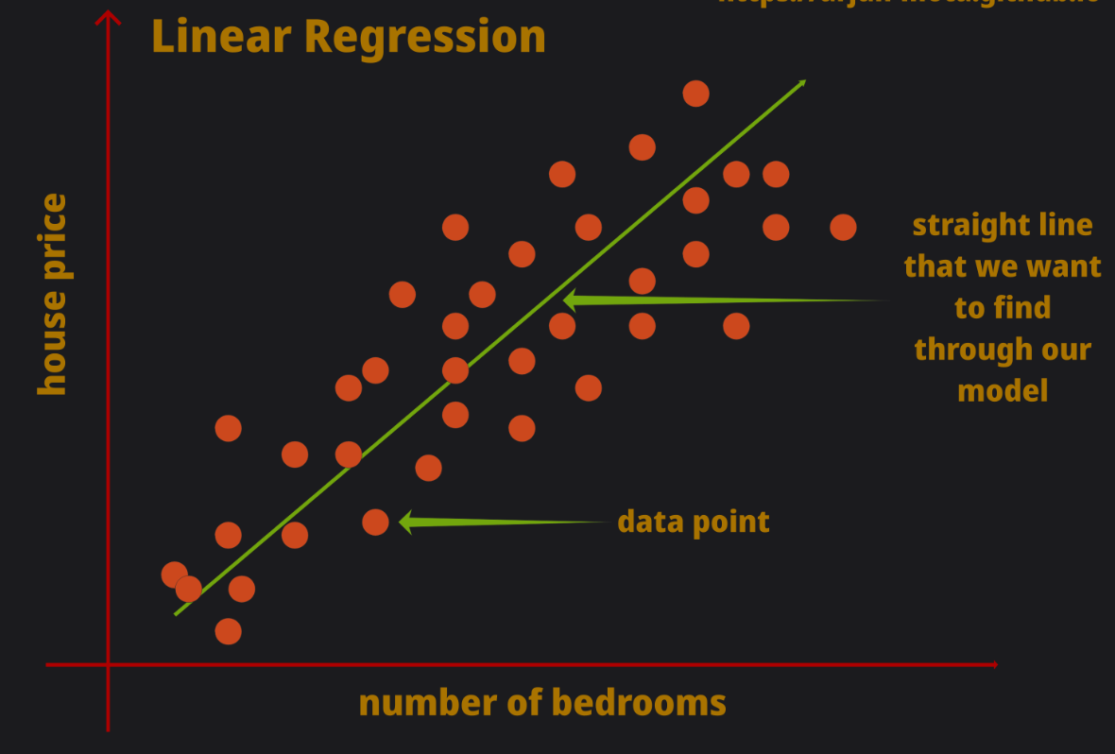
Model Selection
Linear Regression :
Linear regression is a statistical method used to model the relationship between a dependent variable (target) and one or more independent variables (features). It is one of the simplest and most widely used techniques in machine learning and statistics.

Slide 6
Types of Linear Regression:
Simple Linear Regression: One independent variable.
Example: Predicting a person's weight based on their height.
2. Multiple Linear Regression: More than one independent variable.
Example: Predicting house prices based on area, number of rooms, and location.
Equation of Linear Regression:
For simple linear regression:
y=β0+β1x+ε
For multiple linear regression:
y =β0​+β1​x1​+β2​x2​+⋯+βn​xn​+ε

Slide 7
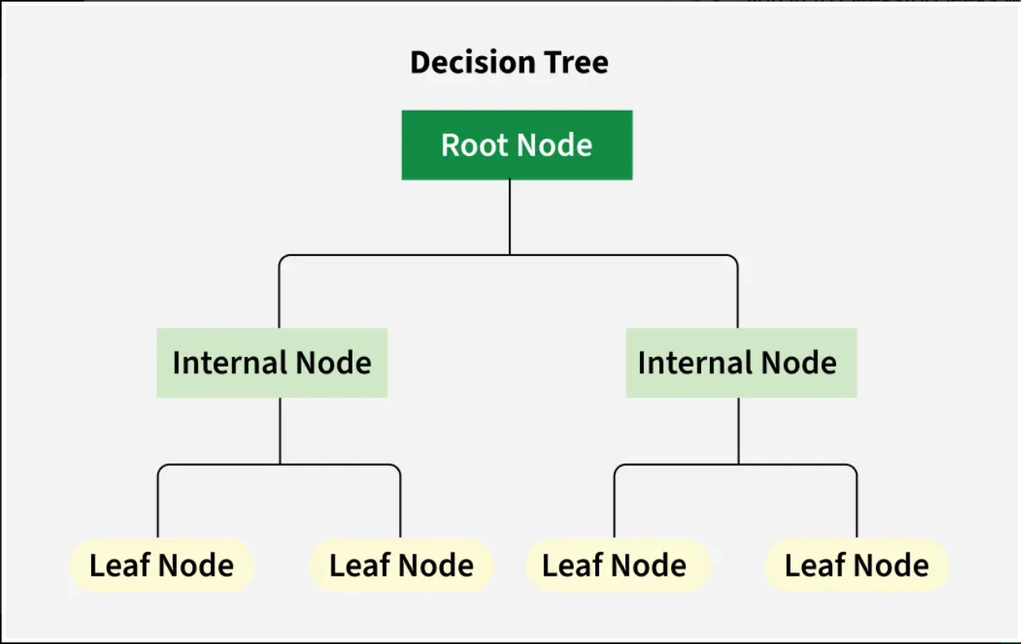
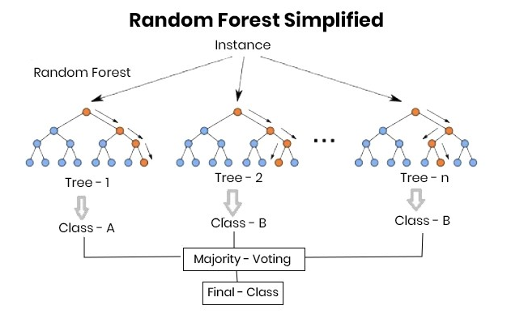
Random Forest :A Random Forest is a collection of decision trees that work together to make predictions.
Decision Tree : Decision tree is a simple diagram that shows different choices and their possible results helping you make decisions easily.

Slide 8
Model Training & Evaluation
Train-test split (e.g., 80-20)
Evaluation metrics:
Mean Absolute Error (MAE)
Root Mean Squared Error (RMSE) etc…….

Slide 9
Results
Best-performing model
Visual: Predicted vs Actual Price plot
Feature importance chart (e.g., from Random Forest)

Slide 10
Challenges
Data quality and preprocessing
Feature selection and dimensionality

Slide 11
Future Work
Use more advanced models (e.g., deep learning)
Incorporate image/text features from product pages
Real-time price tracking

Slide 12
Conclusion
✅ Effective Feature Extraction Key mobile phone attributes such as RAM, ROM, camera quality, battery capacity, and processor type were successfully extracted and analyzed.
📊 Accurate Price Prediction Machine learning models like Linear Regression, Random Forest, and XGBoost showed promising results in predicting mobile phone prices with high accuracy.
🧠 Insights Gained Features like brand, storage, and camera resolution significantly influence the price of a mobile phone.
🚀 Practical Applications The system can help e-commerce platforms, retailers, and consumers make informed pricing and purchasing decisions.

Slide 13
THANK YOU

